Slide 1
CE 395R5- Data Mining
Introductory Thoughts and Goals
Carlos H. Caldas
Professor

Slide 2
Agenda for the first class
Introductions
Motivation
Learning objectives
Course topics
Approach to teaching and learning
Syllabus
Data Mining Overview

Slide 3
Construction Industry Trends
Advances in communications, information technology, and sensing
Industry expectations:
  All project members on-line
  Information easily accessible to all project members
  Full lifecycle support for information technologies systems
  E-Business streamlining all steps and processes in the value system
  Real-time controls

Slide 4
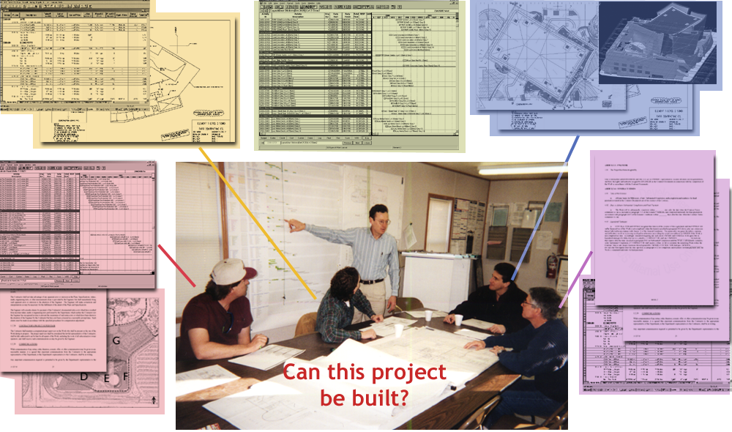
Construction Project Data

Slide 5
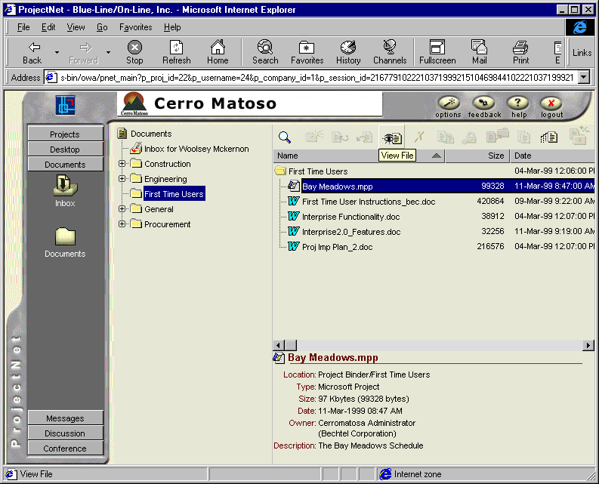
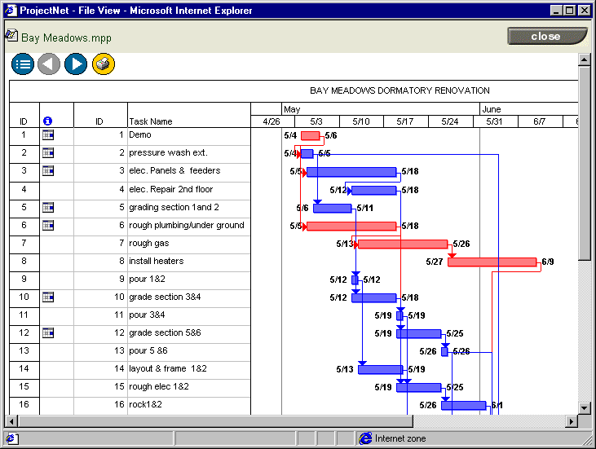
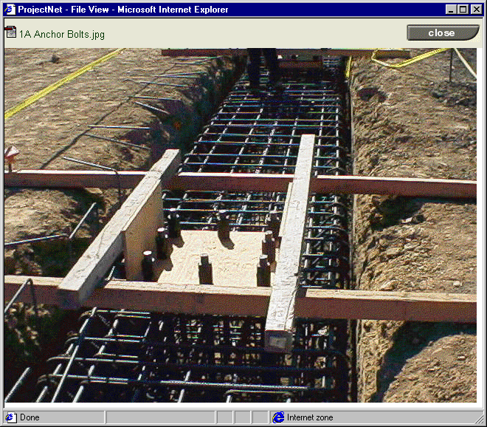
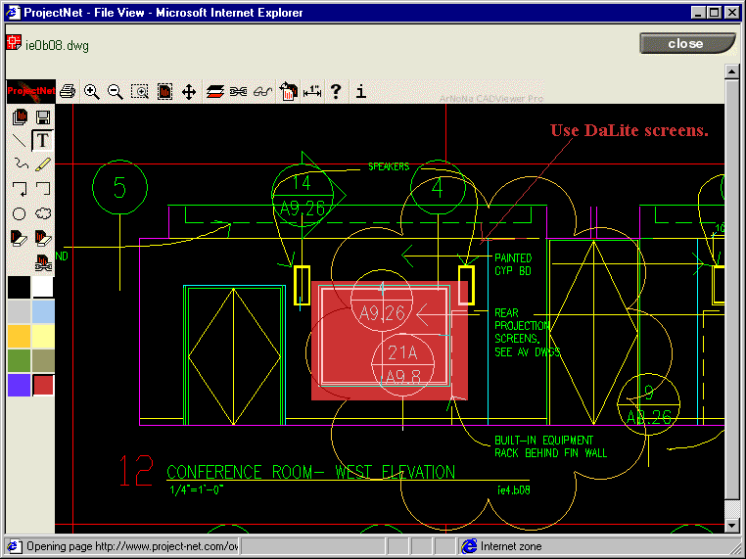
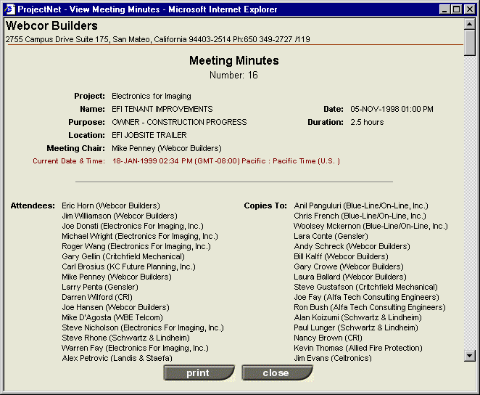
Project Data Sources

Slide 6
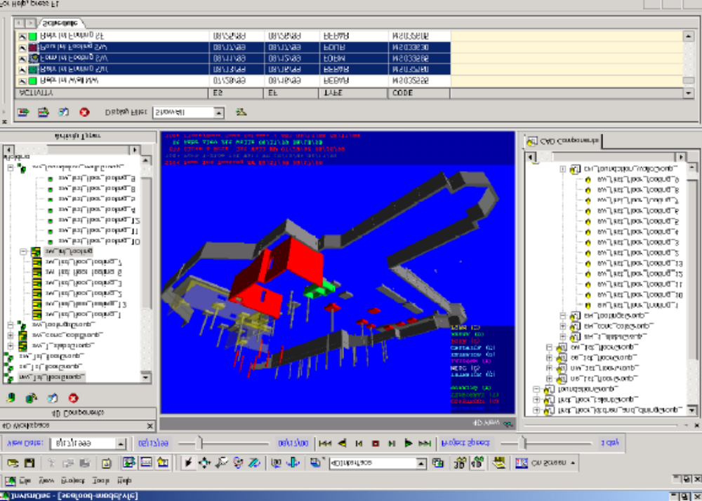
Project Data Sources (2)

Slide 7


Project Data Sources (3)

Slide 8

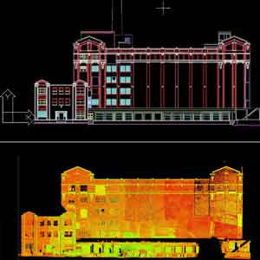

Project Data Sources (4)

Slide 9
Motivation
The information explosion has us drowning in data but often starved of knowledge. Many companies that gather huge amounts of electronic data have now begun applying data mining techniques to their databases to discover and extract pieces of information useful for making smart business decisions.
Effective data mining requires an understanding of concepts from exploratory data analysis, pattern recognition, machine learning, heterogeneous data bases, parallel processing and data visualization, in addition to knowledge of the problem domain.

Slide 10
Data Mining
Data mining (knowledge discovery from data)
  Extraction of interesting (non-trivial, implicit, previously unknown and potentially useful) patterns or knowledge from huge amount of data
  Data mining: a misnomer?
Alternative names
  Knowledge discovery (mining) in databases (KDD), knowledge extraction, data/pattern analysis, data archeology, data dredging, information harvesting, business intelligence, etc.
Watch out: Is everything “data mining”?
  Query processing.
  Expert systems or small ML/statistical programs

Slide 11
Data Mining: Confluence of Multiple Disciplines
Database
Systems
Statistics
Machine
Learning
Data Mining
Visualization
Al
Other
Disciplines

Slide 12
Potential Applications
Data analysis and decision support
  Market analysis and management
    Target marketing, customer relationship management (CRM), market basket analysis, cross selling, market segmentation
  Risk analysis and management
    Forecasting, customer retention, improved underwriting, quality control, competitive analysis
  Fraud detection and detection of unusual patterns (outliers)
Other Applications
  Text mining (news group, email, documents) and Web mining
  Stream data mining
  DNA and bio-data analysis

Slide 13
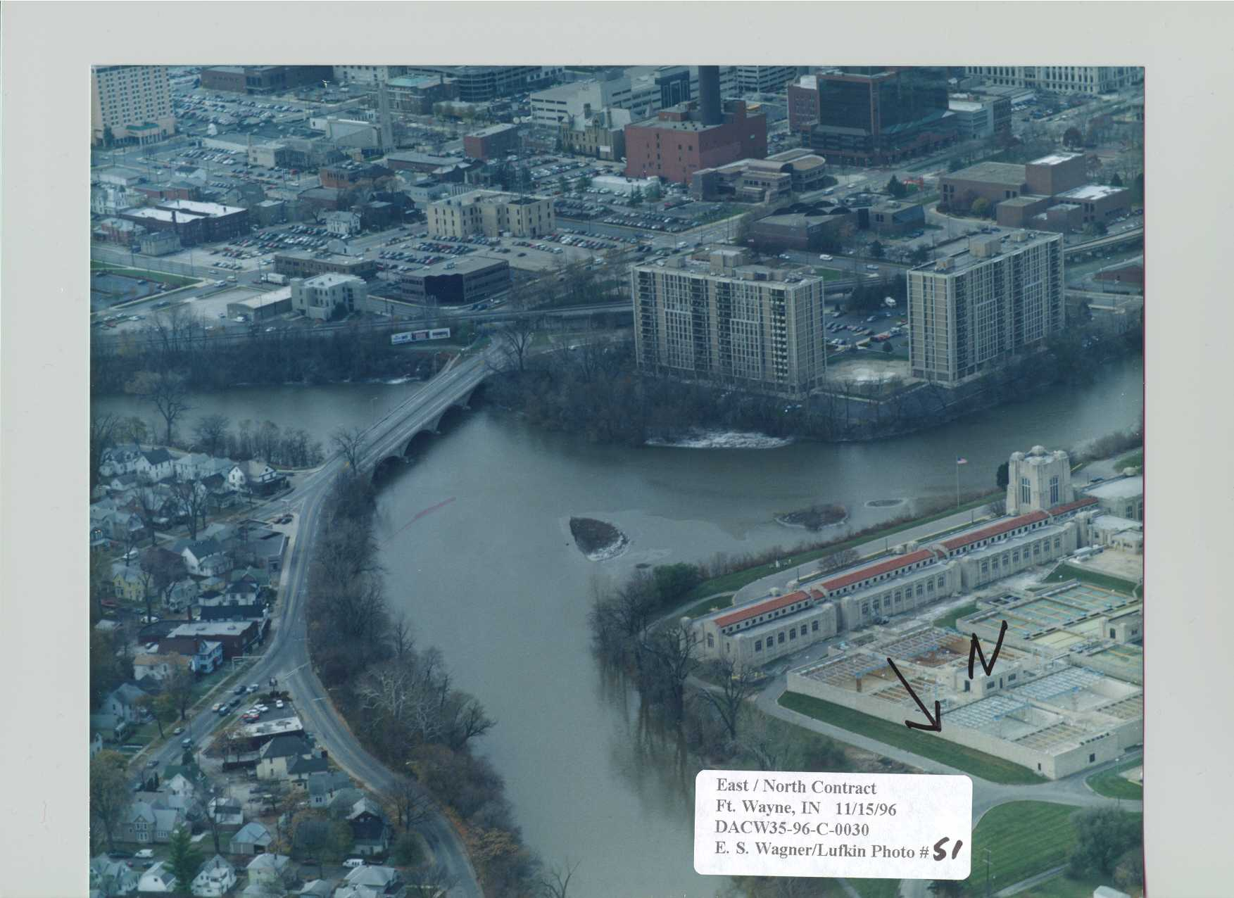
Data Mining Example I
Fort Wayne – IN: Flood Control Project
  Phase I: CTRL-EAST, $4,488,450.21, 11/1/95-10/23/98
  Phase II: East-North, $12,107,880.46, 1/6/97-11/5/98
  Phase III: CTRL, $ 6,018,981.54, 9/14/98-8/6/99
  Phase IV: West, 5/28/99-

Slide 14






Data Mining Example I (2)
Data Collection and Extraction:
Resident Management System - RMS
Manages Civil Works projects.
Was developed by US Corps of Engineers (1996)
Consists of about 80 database tables, each of which has about more than 20 attributes.
Contains data on construction project planning, contract administration, quality assurance, payments, correspondence, submittal management, safety and accident administration, modification processing, and management reporting.
Project manager supplies contract data
Summary reports to speed paperwork.
RMS server
Resident engineer edits data into database
Prime contractor supplies job data
Inspectors write field diaries.
  RMS in a construction project

Slide 15
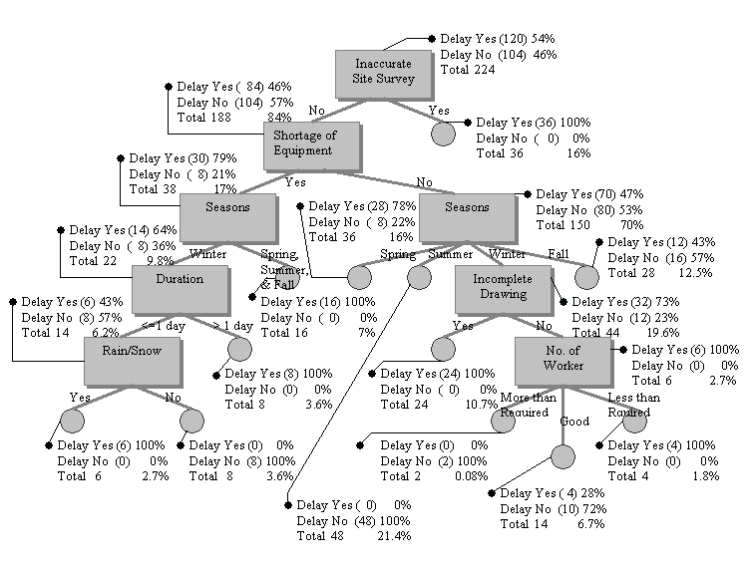
Data Mining Example I (3)
• Results from C4.5 Decision Tree
- Weather considered responsible for delays by site managers, appear not to be the most important cause in determining delays.
- Activities with “Inaccurate Site Surveys” are always delayed in the schedule.
- Shortage of Equipment, Seasons, and Incomplete Drawing are also very significant factors compared to other factors.

Slide 16
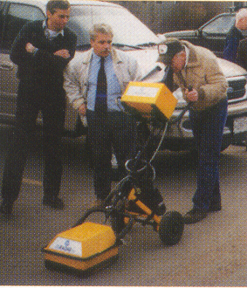
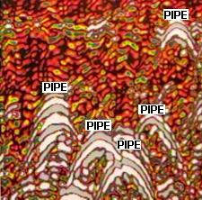
Data Mining Example I (4)
Ground penetrating radar is a good investment

Slide 17
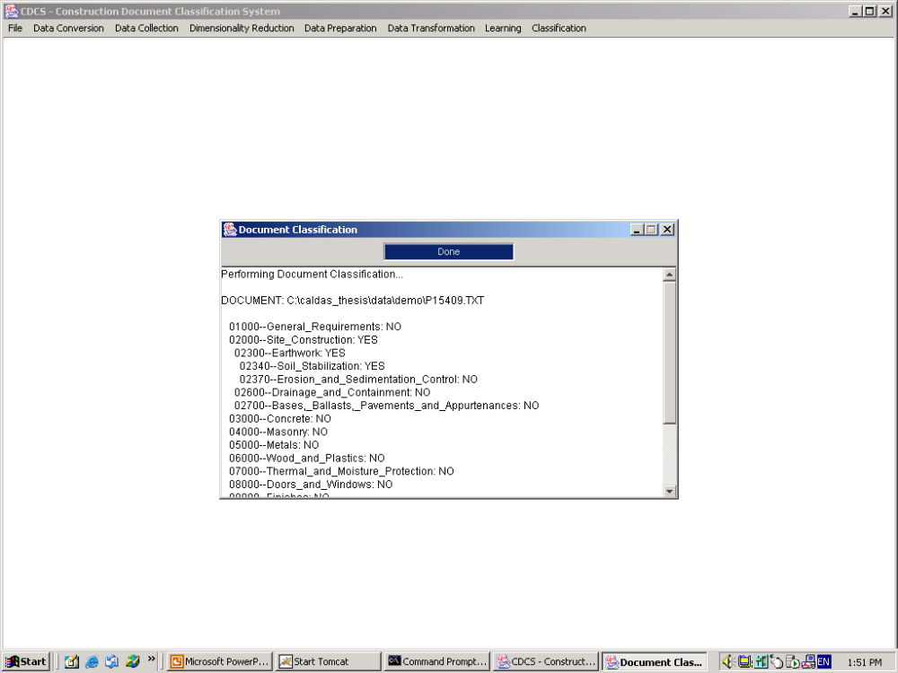
Data Mining Example II (1)

Slide 18
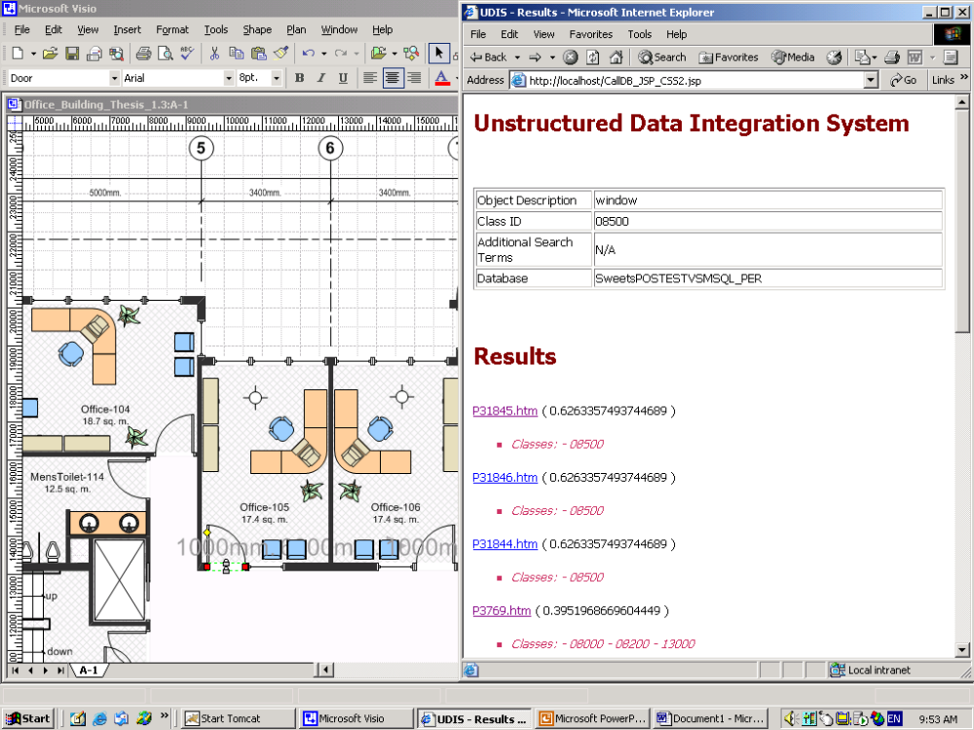
Data Mining Example II (2)

Slide 19
Learning Objectives
Understand the fundamentals of data mining and knowledge discovery in databases.
Demonstrate how knowledge discovery in databases can be used to support construction engineering and project management.
Apply DM/KDD techniques for data classification, prediction, clustering, and mining association rules.
Recognize the design, analysis, and implementation issues for DM/KDD techniques in civil engineering.
Analyze, evaluate, and recommend DM/KDD systems for construction owners, contractors, and/or project managers.

Slide 20
Topics
DATA MINING AND KNOWLEDGE DISCOVERY IN DATABASES
  Introduction and Overview
  Basic Concepts
ENGINEERING DATA
  Data Types
  Data Pre-Processing
  Data Exploration
  Visualization

Slide 21
Topics (2)
DATA MINIG TASKS
  Classification
  Prediction
  Association Rules
  Clustering
MINING COMPLEX DATA TYPES
TRENDS IN DATA MINING
CONSTRUCTION ENGINEERING AND PROJECT MANAGEMENT APPLICATIONS

Slide 22
Approach to Teaching and Learning
Discussions
Learn by exploring and doing
Participatory, work as a group with individual contributions, presentations
Software demonstration as needed

Slide 23
As a Student
Industry
  Identify, Analyze, Recommend, Use
Research
  Identify Problems / Propose Solutions
  Contribute to the Body of Knowledge

Slide 24
Syllabus

